Slide 1
Information Retrieval on the Web:
Web, Characteristics, and Crawling
Weimao Ke
wk@drexel.edu

Slide 2
Outline
Web Basics
Overview of Web and IR on the Web
Spam and search engine optimization
Crawling

Slide 3
WEB BASICS

Slide 4

Basic terms on the Web
URL: Uniform Resource Locator
  The address of a Web page/document
(X)HTML: Hypertext Markup Language
  The language to author Web pages
Hyperlink: a references to a document on the Web
  A URL with anchor text (label)
Anchor text: label of a hyperlink reference
URL: http://www.ischool.drexel.edu/faculty/wke
hyperlink
Anchor text: Instructor’s Home Page

Slide 5
URL Example
Example: http://www.drexel.edu/about/history/brief.aspx
  Protocol: HTTP, hypertext transfer protocol
  Domain name: www.drexel.edu
  Port: default 80
    The above example is actually
    http://www.drexel.edu:80/about/history/brief.aspx
  Page: /about/history/brief.aspx
    Directory/folder: “/about/history/”
    File name: brief.aspx
When you type a URL in the browser and hit Enter
  Browser sends a request
    of the page (brief.aspx)
    to the server (www.drexel.edu) at port 80
    using the indicated protocol (HTTP)
  Servers sends HTML content back to browser
  Browser displays the content

Slide 6

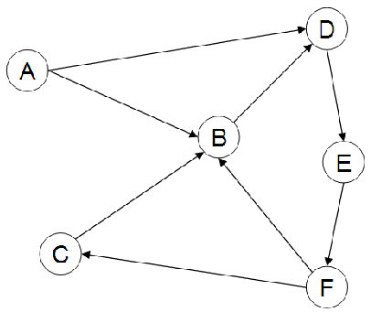
The Web as a graph
A page is seen as a node
A hyperlink: an edge / arc
In-links and out-links
  A has 2 out-links
  Out-degree of A = 2
  B has 3 in-links
  In-degree of B = 3
link
page 1
page 2

Slide 7
OVERVIEW
User, Content, and IR Systems on the Web

Slide 8
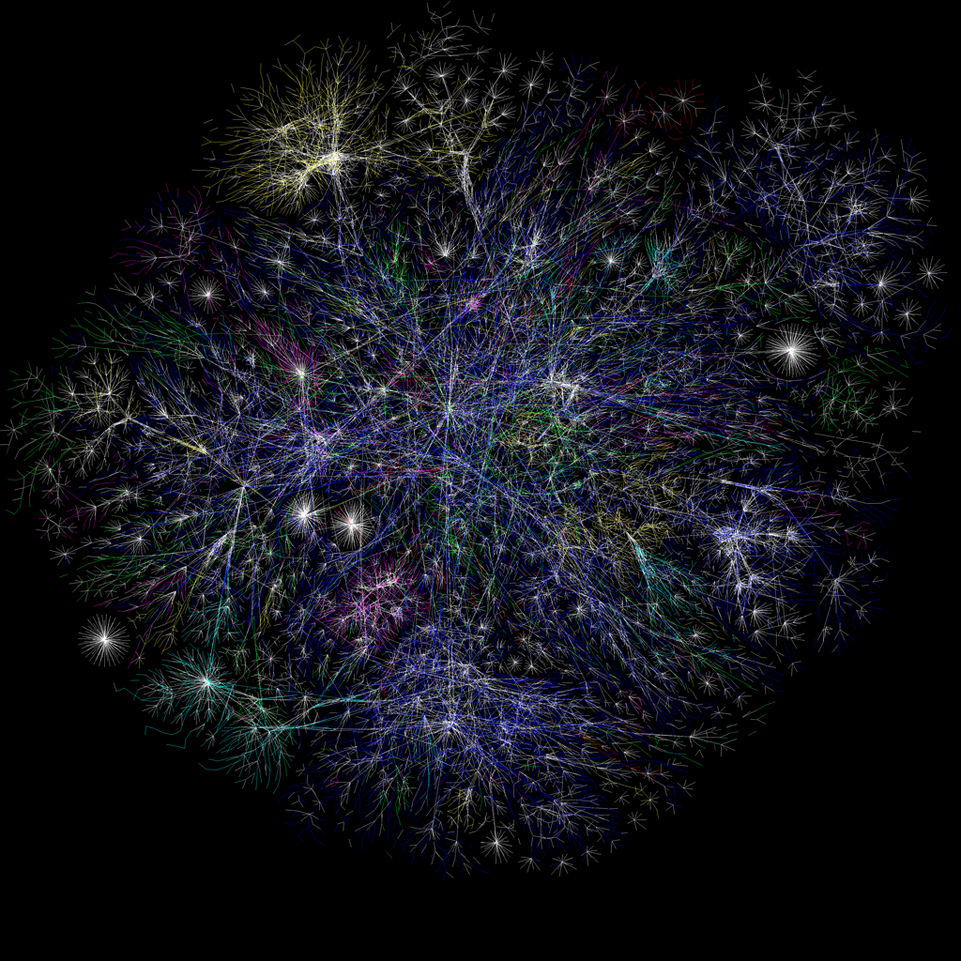

What does the Internet look like?
A tree?
Each branch a domain such as drexel.edu
More at: http://www.opte.org/maps/

Slide 9
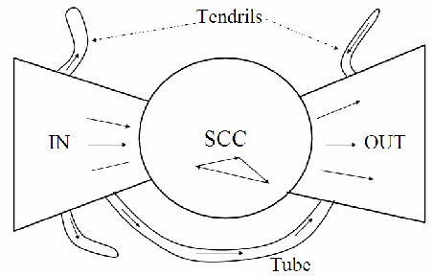
What does the Web look like?
A bowtie
  Three major components: IN, SCC, OUT
  Tubes and tendrils

Slide 10
Size of the Web
Number of Web Sites:
  1991: August 6, Tim Berners-Lee published the Web
  1994: 700 - 12,000 web sites
  1991-1997: Explosive growth, at a rate of 850% per year.
  1998-2001: Rapid growth, at a rate of 150% per year.
  2002-2006: Maturing growth, at a rate of 25% per year.
  2007: over 100 million web sites
  2010: about 200 million web sites
  …
  2020: 2 billion websites (400 million active)
  http://www.useit.com/alertbox/web-growth.html
  https://hostingtribunal.com/blog/how-many-websites/#gref

Slide 11
Size of the Web
Number of Web Pages:
  1997: 200 million pages
  1998: 800 million pages
  2005: 11.5 billion pages
  2007: 22.5 billion pages
  2010: trillion+ pages
  …
  2020: lost count, but Google indexed < 60 billion
Dynamic pages
  such as those on facebook, quora, twitter, etc.
Deep web, dark web, …

Slide 12
What remains…
Little change in terms of..
  (X)HTML: standard markup language on the web
  Hyperlinks: how pages connect to one another
  “Small world”: 19-degree separation
    Albert and Barabasi, 1999
  Browser/Server architecture
    Browser: the client (on your computer)
    Web Server: the server (e.g., www.ischool.drexel.edu)

Slide 13
Brief (non-technical) history
Early keyword-based engines ca. 1995-1997
  Altavista, Excite, Infoseek, Inktomi, Lycos
Paid search ranking: Goto (morphed into Overture.com → Yahoo!)
  Your search ranking depended on how much you paid
  Auction for keywords: casino was expensive!

Slide 14
Brief (non-technical) history
1998+: Link-based ranking pioneered by Google
  Blew away all early engines
  Great user experience, in search of a business model
  Meanwhile Goto/Overture’s annual revenues were nearing $1 billion
Result: Google added paid search “ads” to the side, independent of search results
  Yahoo followed suit, acquiring Overture (for paid placement) and Inktomi (for search)
2005+: Google gains search share, dominating in Europe and very strong in North America
  2009: Yahoo! and Microsoft propose combined paid search offering

Slide 15
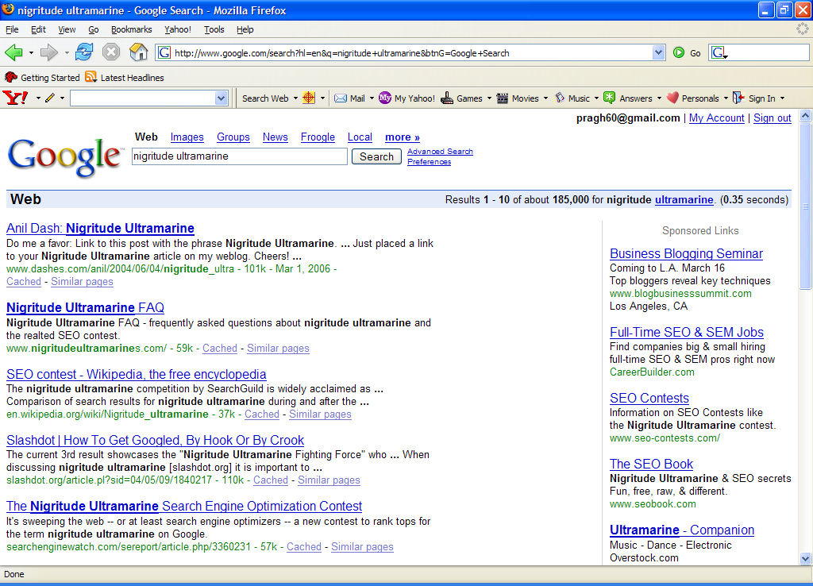
Paid
Search Ads
Algorithmic results.

Slide 16
Classic Web IR Model
Web
(part of the Internet)
Google
1. collecting information/pages
3. searching
2. indexing

Slide 17

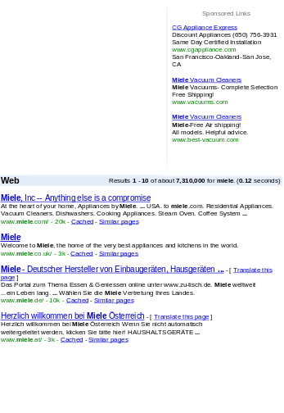

Another View of the Model
Sec. 19.4.1
User
Web spider
Search
Indexer
The Web
Indexes
Ad indexes

Slide 18
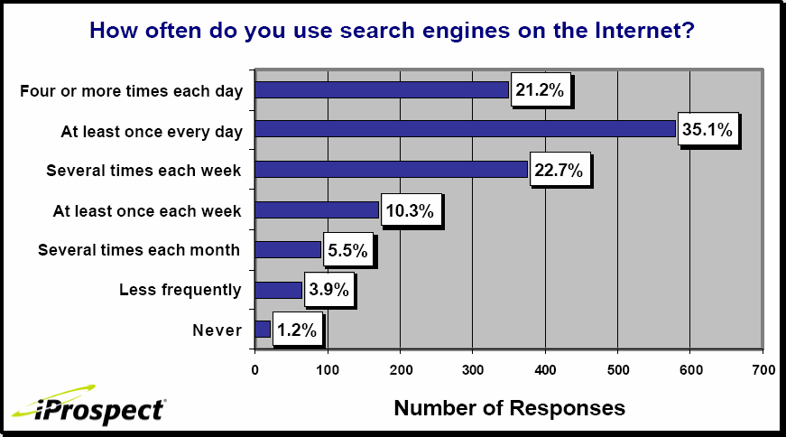
Search Engine Use

Slide 19
Think about these questions:
  Do web users who make the same query on a search engine always have the same information need?
  Do web pages that have the same keywords always have the same context?
  Is the content on a web page always the same? Have they ever changed? How often do they change?
  When you search, do you want to find the web pages with recently updated information or those that are created years ago and have never been changed.

Slide 20
User Needs
Sec. 19.4.1
User information needs on the Web
  Informational – want to learn about something (~40% / 65%)
  Navigational – want to go to that page (~25% / 15%)
  Transactional – want to do something (web-mediated) (~35% / 20%)
    Access a service
    Downloads
    Shop
e.g., seeking information about “vector space”
e.g., to find the website of United Airlines
Seattle weather
Mars surface images
Canon S410

Slide 21
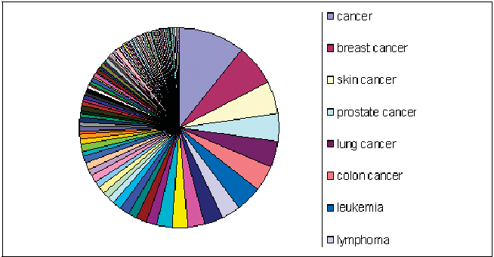
Query Complexity Distribution
Power law (like Zipf’s Law): few popular broad queries, many rare specific queries

Slide 22
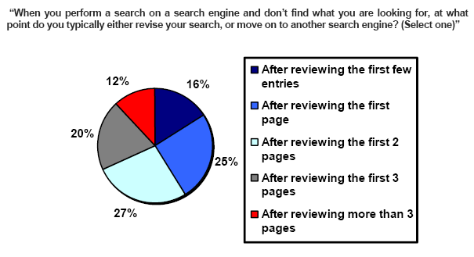
How far do people look for results?
(Source: iprospect.com WhitePaper_2006_SearchEngineUserBehavior.pdf)

Slide 23
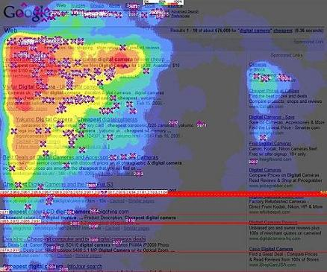
How do you look at search results?
Eye tracking
People pay attention to:
  Top 2 – 3 items
  Sponsored links
http://www.iqcontent.com/blog/2006/07/eyetracking-and-google-search-results/

Slide 24
Users’ empirical evaluation of results
Quality of pages varies widely
  Relevance is not enough
  Other desirable qualities (non IR!!)
    Content: Trustworthy, diverse, non-duplicated, well maintained
    Web readability: display correctly & fast
    No annoyances: pop-ups, etc
  Can you find a page and guarantee its quality as well? Keyword does not tell you about the quality. Are there any other mechanisms that help in measuring the quality?
Precision vs. recall
  On the web, recall seldom matters
What matters
  Precision at 1? Precision above the fold?
  Comprehensiveness – must be able to deal with obscure queries
    Recall matters when the number of matches is very small
User perceptions may be unscientific, but are significant over a large aggregate

Slide 25
Users’ empirical evaluation of engines
Relevance and validity of results
UI – Simple, no clutter, error tolerant
Trust – Results are objective
Coverage of topics for polysemic queries
Pre/Post process tools provided
  Mitigate user errors (auto spell check, search assist,…)
  Explicit: Search within results, more like this, refine ...
  Anticipative: related searches
Deal with idiosyncrasies
  Web specific vocabulary
    Impact on stemming, spell-check, etc
  Web addresses typed in the search box

Slide 26
The Web document collection
Sec. 19.2
No design/co-ordination
Distributed content creation, linking, democratization of publishing
Content includes truth, lies, obsolete information, contradictions …
Unstructured (text, html, …), semi-structured (XML, annotated photos), structured (Databases)…
Scale much larger than previous text collections … but corporate records are catching up
Growth – slowed down from initial “volume doubling every few months” but still expanding
Content can be dynamically generated
The Web

Slide 27
The Web: Very dynamic content
A page without a static html version
  E.g., current status of flight AA129
  Current availability of rooms at a hotel
Usually, assembled at the time of a request from a browser
  Typically, URL has a ‘?’ character in it
AA129
Application server
Browser
Back-end
databases
Can you index the dynamic content?

Slide 28
SPAM
SPAM and Search Engine Optimization

Slide 29
The trouble with paid search ads …
Sec. 19.2.2
It costs money. What’s the alternative?
Search Engine Optimization:
  “Tuning” your web page to rank highly in the algorithmic search results for select keywords
  Alternative to paying for placement
  Thus, intrinsically a marketing function
Performed by companies, webmasters and consultants (“Search engine optimizers”) for their clients
Some perfectly legitimate, some very shady

Slide 30
Search engine optimization (Spam)
Sec. 19.2.2
Motives
  Commercial, political, religious, lobbies
  Promotion funded by advertising budget
Operators
  Contractors (Search Engine Optimizers) for lobbies, companies
  Web masters
  Hosting services
Forums
  E.g., Web master world ( www.webmasterworld.com )
    Search engine specific tricks
    Discussions about academic papers ☺

Slide 31
Simplest forms
Sec. 19.2.2
First generation engines relied heavily on tf/idf
  The top-ranked pages for the query maui resort were the ones containing the most maui’s and resort’s
SEOs responded with dense repetitions of chosen terms
  e.g., maui resort maui resort maui resort
  Often, the repetitions would be in the same color as the background of the web page
    Repeated terms got indexed by crawlers
    But not visible to humans on browsers
Pure word density cannot
be trusted as an IR signal

Slide 32
Variants of keyword stuffing
Sec. 19.2.2
Misleading meta-tags, excessive repetition
Hidden text with colors, style sheet tricks, etc.
Meta-Tags =
“… London hotels, hotel, holiday inn, hilton, discount, booking, reservation, sex, mp3, britney spears, viagra, …”

Slide 33
Cloaking
Sec. 19.2.2
Serve fake content to search engine spider
DNS cloaking: Switch IP address. Impersonate
SPAM
Y
Is this a Search
Engine spider?
N
Real
Doc
Cloaking

Slide 34

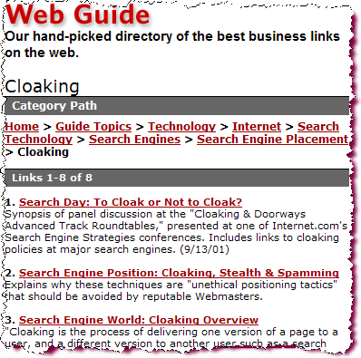
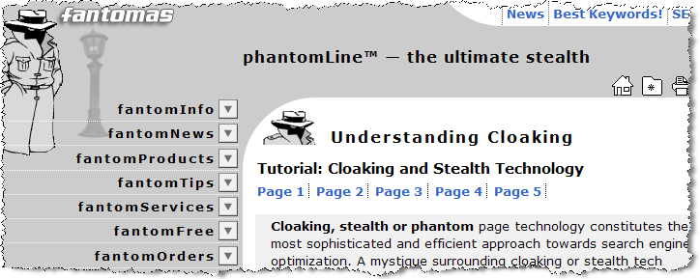
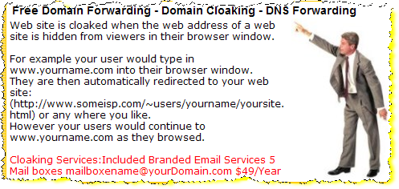
The spam industry

Slide 35
More spam techniques
Sec. 19.2.2
Doorway pages
  Pages optimized for a single keyword that re-direct to the real target page
Link spamming
  Mutual admiration societies, hidden links, awards
  Domain flooding: numerous domains that point or re-direct to a target page
Robots
  Fake query stream – rank checking programs
    “Curve-fit” ranking programs of search engines
  Millions of submissions via Add-Url

Slide 36
The war against spam
Quality signals - Prefer authoritative pages based on:
  Votes from authors (linkage signals)
  Votes from users (usage signals)
Policing of URL submissions
  Anti robot test
Limits on meta-keywords
Robust link analysis
  Ignore statistically implausible linkage (or text)
  Use link analysis to detect spammers (guilt by association)
Spam recognition by machine learning
  Training set based on known spam
Family friendly filters
  Linguistic analysis, general classification techniques, etc.
  For images: flesh tone detectors, source text analysis, etc.
Editorial intervention
  Blacklists
  Top queries audited
  Complaints addressed
  Suspect pattern detection

Slide 37
More on spam
Web search engines have policies on SEO practices they tolerate/block
  http://help.yahoo.com/help/us/ysearch/index.html
  http://www.google.com/intl/en/webmasters/
Adversarial IR: the unending (technical) battle between SEO’s and web search engines
Research http://airweb.cse.lehigh.edu/

Slide 38
CRAWLING
Information Collection

Slide 39
Basic crawler operation
Sec. 20.2
Begin with known “seed” URLs
Fetch and parse them
  Extract URLs they point to
  Place the extracted URLs on a queue
Fetch each URL on the queue and repeat

Slide 40
Crawling picture
Sec. 20.2
URLs crawled
and parsed
Unseen Web
Seed
pages
URLs frontier
Web

Slide 41
Simple picture – complications
Sec. 20.1.1
Web crawling isn’t feasible with one machine
  All of the above steps distributed
Malicious pages
  Spam pages
  Spider traps – some dynamically generated
Even non-malicious pages pose challenges
  Latency/bandwidth to remote servers vary
  Webmasters’ stipulations
    How “deep” should you crawl a site’s URL hierarchy?
  Site mirrors and duplicate pages
Politeness – don’t hit a server too often

Slide 42
What any crawler must do
Sec. 20.1.1
Be Polite: Respect implicit and explicit politeness considerations
  Only crawl allowed pages
  Respect robots.txt (more on this shortly)
Be Robust: Be immune to spider traps and other malicious behavior from web servers

Slide 43
What any crawler should do
Sec. 20.1.1
Be capable of distributed operation: designed to run on multiple distributed machines
Be scalable: designed to increase the crawl rate by adding more machines
Performance/efficiency: permit full use of available processing and network resources

Slide 44
What any crawler should do
Sec. 20.1.1
Fetch pages of “higher quality” first
Continuous operation: Continue fetching fresh copies of a previously fetched page
Extensible: Adapt to new data formats, protocols

Slide 45
Updated crawling picture
Sec. 20.1.1
URLs crawled
and parsed
Unseen Web
Seed
Pages
URL frontier
Crawling thread

Slide 46
URL frontier
Sec. 20.2
Can include multiple pages from the same host
Must avoid trying to fetch them all at the same time
Must try to keep all crawling threads busy

Slide 47
Explicit and implicit politeness
Sec. 20.2
Explicit politeness: specifications from webmasters on what portions of site can be crawled
  robots.txt
Implicit politeness: even with no specification, avoid hitting any site too often

Slide 48
Robots.txt
Sec. 20.2.1
Protocol for giving spiders (“robots”) limited access to a website, originally from 1994
  www.robotstxt.org/wc/norobots.html
Website announces its request on what can(not) be crawled
  For a URL, create a file URL/robots.txt
  This file specifies access restrictions

Slide 49
Robots.txt Example
Sec. 20.2.1
The following rule in robots.txt indicates:
  “No robot should visit any URL starting with /yoursite/temp/, except the robot called searchengine. ”
User-agent: *
Disallow: /yoursite/temp/
User-agent: searchengine
Disallow:

Slide 50
Processing steps in crawling
Sec. 20.2.1
Pick a URL from the frontier
Fetch the document at the URL
Parse the URL
  Extract links from it to other docs (URLs)
Check if URL has content already seen
  If not, add to indexes
For each extracted URL
  Ensure it passes certain URL filter tests
  Check if it is already in the frontier (duplicate URL elimination)
Which one?
e.g., only crawl .edu, obey robots.txt, etc.

Slide 51
Basic crawl architecture
Sec. 20.2.1
WWW
DNS
Doc
FP’s
robots
filters
URL
set
Parse
Fetch
Content
seen?
URL
filter
Dup
URL
elim
URL Frontier

Slide 52
DNS (Domain Name Server)
Sec. 20.2.2
A lookup service on the internet
  Given a URL, retrieve its IP address
  Service provided by a distributed set of servers – thus, lookup latencies can be high (even seconds)

Slide 53
Content seen?
Sec. 20.2.1
Duplication is widespread on the web
If the page just fetched is already in the index, do not further process it
This is verified using document fingerprints or shingles

Slide 54
URL frontier: two main considerations
Sec. 20.2.3
Politeness: do not hit a web server too frequently
Freshness: crawl some pages more often than others
  e.g., pages (such as News sites) whose content changes often
These goals may conflict each other.

Slide 55
Resources
IIR Chapters 19, 20

